Slide 1
FACTOR MODELS
(Chapter 6)
Markowitz Model
Employment of Factor Models
Essence of the Single-Factor Model
The Characteristic Line
Expected Return in the Single-Factor Model
Single-Factor Model’s Simplified Formula for
Portfolio Variance
Explained Versus Unexplained Variance
Multi-Factor Models
Models for Estimating Expected Return

Slide 2
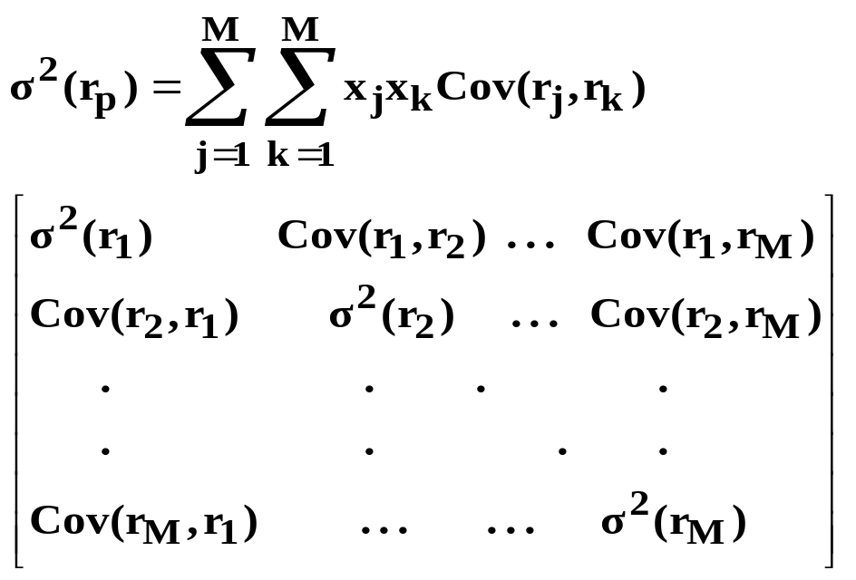

Markowitz Model
Problem: Tremendous data requirement.
  Number of security variances needed = M.
  Number of covariances needed = (M² - M)/2
  Total = M + (M² - M)/2
Example: (100 securities)
  100 + (10,000 - 100)/2 = 5,050
Therefore, in order for modern portfolio theory to be usable for large numbers of securities, the process had to be simplified. (Years ago, computing capabilities were minimal)

Slide 3
Employment of Factor Models
To generate the efficient set, we need estimates of expected return and the covariances between the securities in the available population. Factor models may be used in this regard.
Risk Factors – (rate of inflation, growth in industrial production, and other variables that induce stock prices to go up and down.)
  May be used to evaluate covariances of return between securities.
Expected Return Factors – (firm size, liquidity, etc.)
  May be used to evaluate expected returns of the securities.
In the discussion that follows, we first focus on risk factor models. Then the discussion shifts to factors affecting expected security returns.

Slide 4
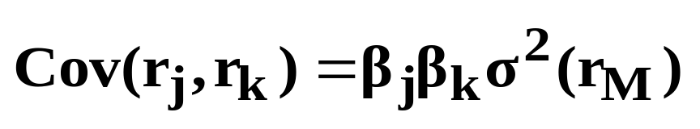
Essence of the Single-Factor Model
Fluctuations in the return of a security relative to that of another (i.e., the correlation between the two) do not depend upon the individual characteristics of the two securities. Instead, relationships (covariances) between securities occur because of their individual relationships with the overall market (i.e., covariance with the market).
If Stock (A) is positively correlated with the market, and if Stock (B) is positively correlated with the market, then Stocks (A) and (B) will be positively correlated with each other.
Given the assumption that covariances between securities can be accounted for by the pull of a single common factor (the market), the covariance between any two stocks can be written as:

Slide 5
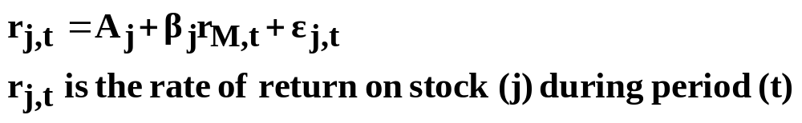
The Characteristic Line
(See Chapter 3 for a Review of the Statistics)
Relationship between the returns on an individual security and the returns on the market portfolio:
A_{j} = intercept of the characteristic line (the expected rate of return on stock (j) should the market happen to produce a zero rate of return in any given period).
β_{j} = beta of stock (j); the slope of the characteristic line.
ε_{j,t} = residual of stock (j) during period (t); the vertical distance from the characteristic line.

Slide 6
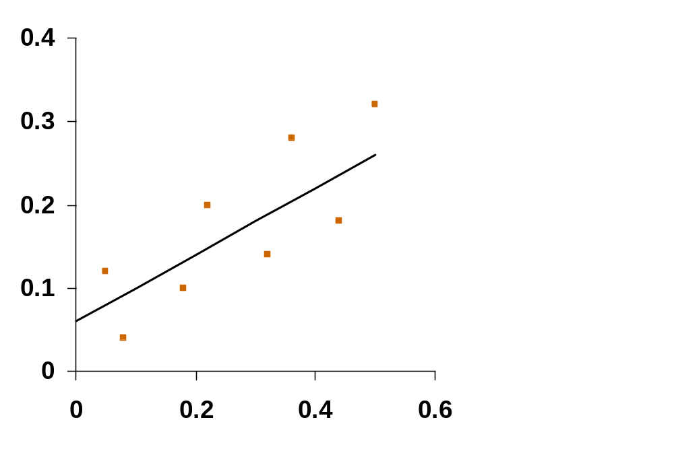
Graphical Display of the Characteristic Line
r_{j,t}
= β_{j}
A_{j}
r_{M,t}

Slide 7
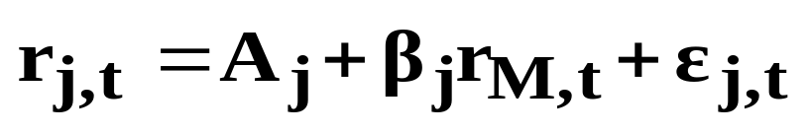
The Characteristic Line (Continued)
Note: A stock’s return can be broken down into two parts:
  Movement along the characteristic line (changes in the stock’s returns caused by changes in the market’s returns).
  Deviations from the characteristic line (changes in the stock’s returns caused by events unique to the individual stock).
Movement along the line: A_{j} + β_{j}r_{M,t}
Deviation from the line: ε_{j,t}

Slide 8
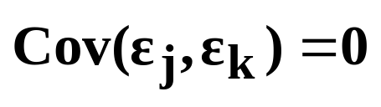
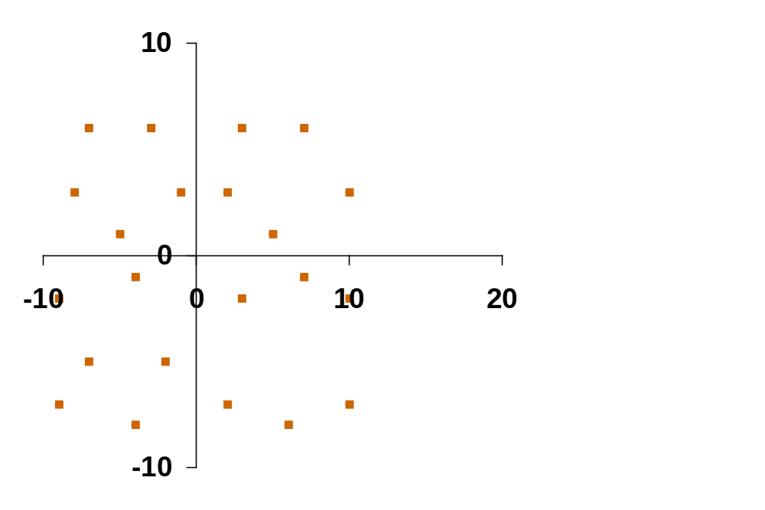
Major Assumption of the Single-Factor Model
There is no relationship between the residuals of one stock and the residuals of another stock (i.e., the covariance between the residuals of every pair of stocks is zero).
Stock j’s Residuals (%)
Stock k’s Residuals (%)

Slide 9
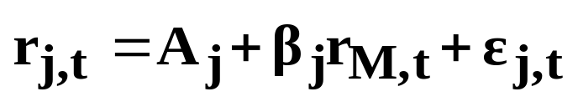
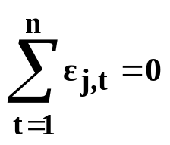
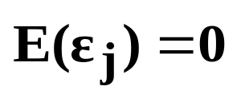
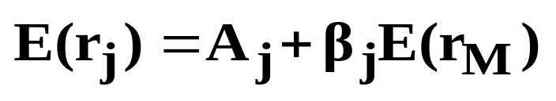
Expected Return in the Single-Factor Model
Actual Returns:
Expected Residual:
  Given the characteristic line is truly the line of best fit, the sum of the residuals would be equal to zero
  Therefore, the expected value of the residual for any given period would also be equal to zero:
Expected Returns:
  Given the characteristic line, and an expected residual of zero, the expected return of a security according to the single-factor model would be:

Slide 10
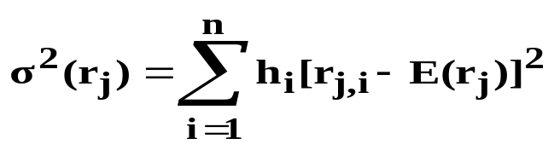
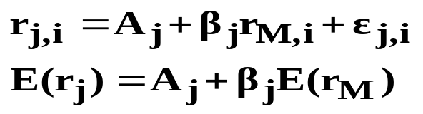
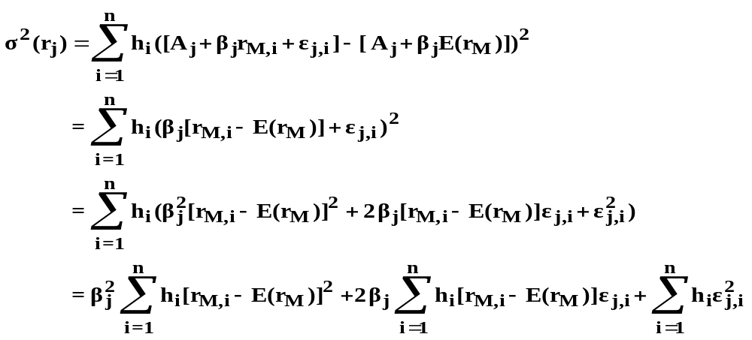
Single-Factor Model’s Simplified Formula for Portfolio Variance
Variance of an Individual Security:
Given:
It Follows That:

Slide 11
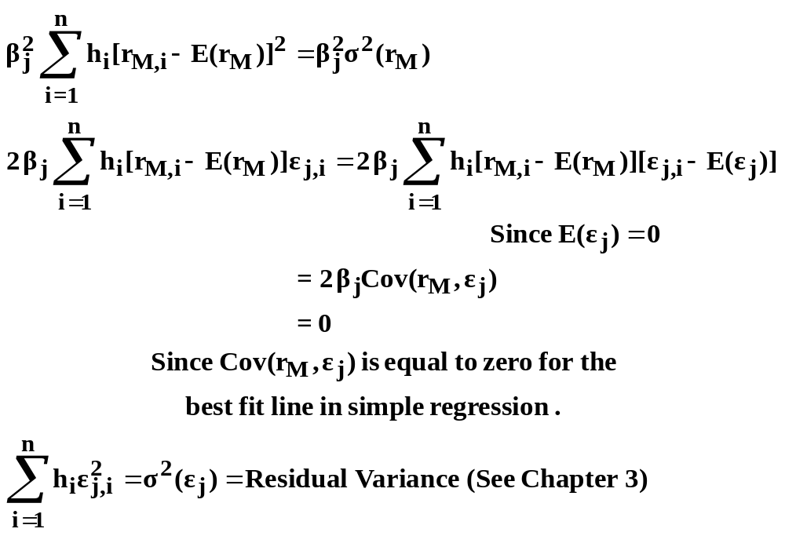
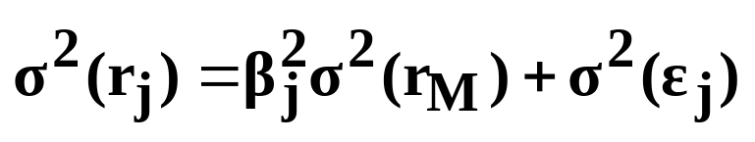
Note:
Therefore:

Slide 12
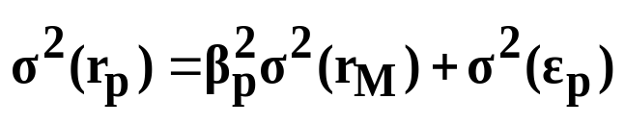
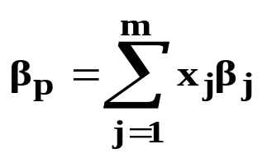
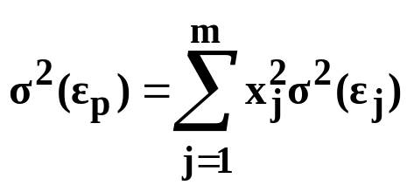
Variance of a Portfolio
Same equation as the one for individual security variance:
Relationship between security betas & portfolio betas
Relationship between residual variances of stocks, and the residual variance of a portfolio, given the index model assumption.
The residual variance of a portfolio is a weighted average of the residual variances of the stocks in the portfolio with the weights squared.

Slide 13
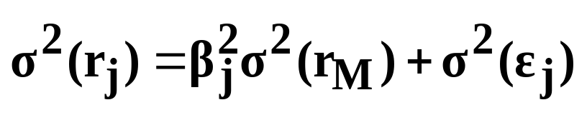
Explained Vs. Unexplained Variance
(Systematic Vs. Unsystematic Risk)
Total Risk = Systematic Risk + Unsystematic Risk
Systematic: That part of total variance which is explained by the variance in the market’s returns.
Unsystematic: The unexplained variance, or that part of total variance which is due to the stock’s unique characteristics.

Slide 14
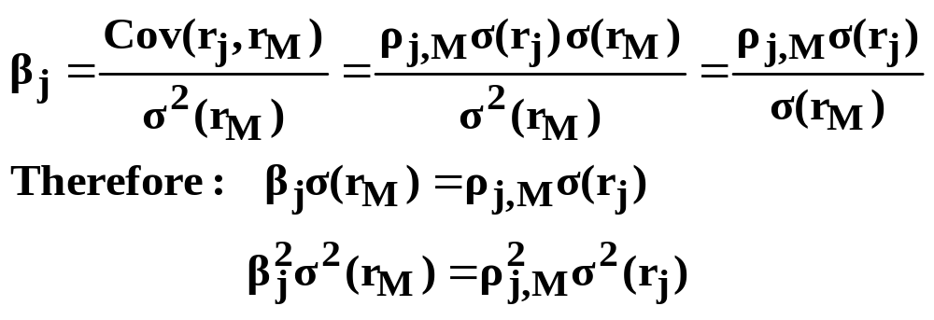
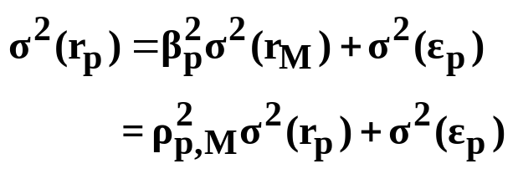
Note:
[i.e., β_{j}²σ²(r_{M}) is equal to the coefficient of determination (the % of the variance in the security’s returns explained by the variance in the market’s returns) times the security’s total variance]
Total Variance = Explained + Unexplained
As the number of stocks in a portfolio increases, the residual variance becomes smaller, and the coefficient of determination becomes larger.

Slide 15
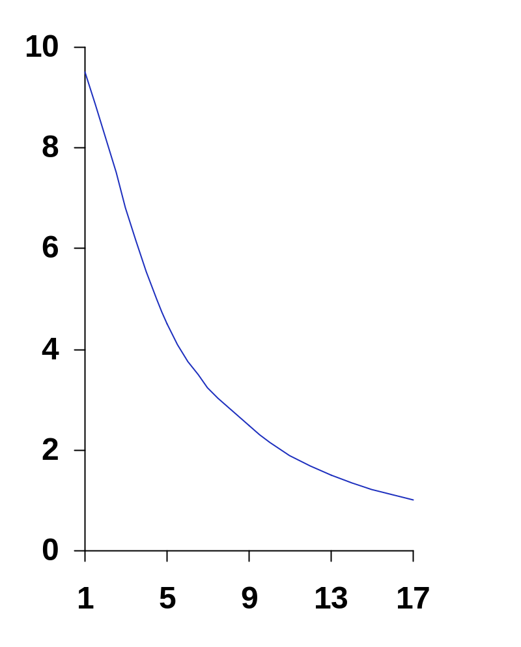
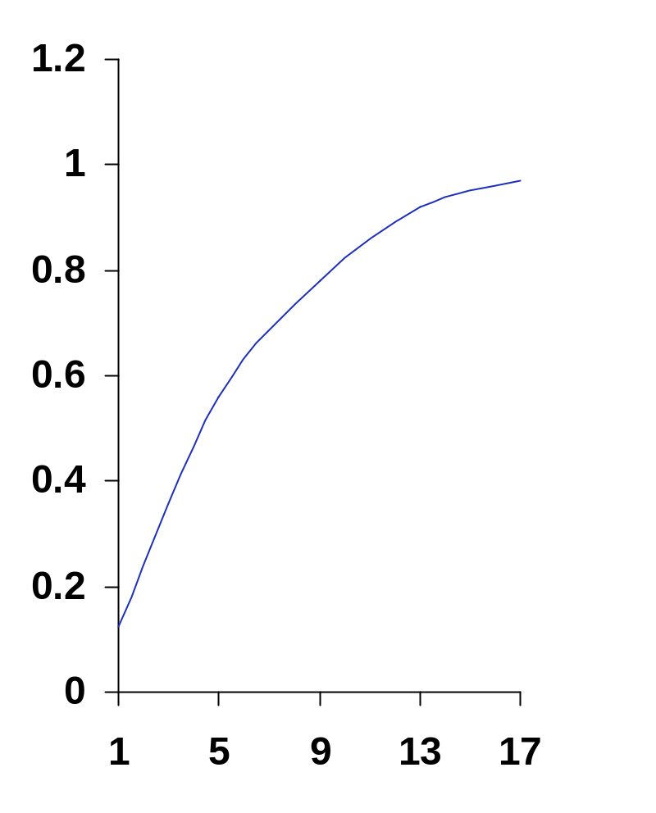
Explained Vs. Unexplained Variance
(A Graphical Display)
Residual Variance
Coefficient of Determination
Number of Stocks
Number of Stocks

Slide 16
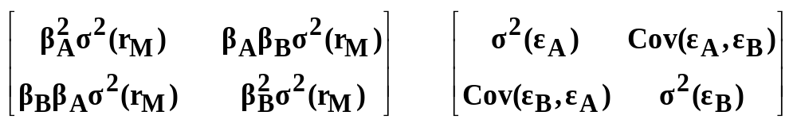
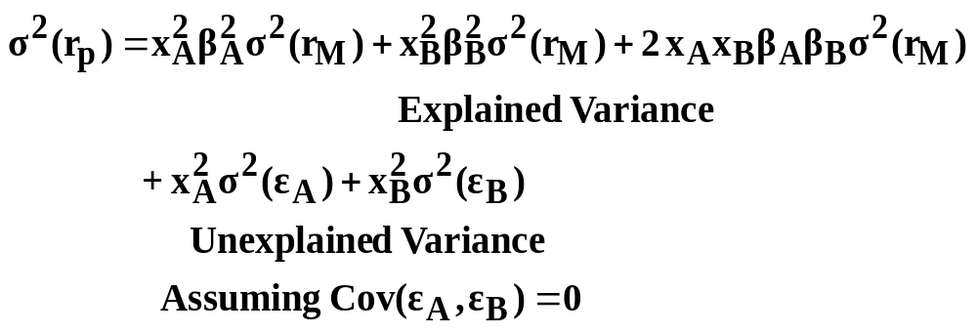
Explained Vs. Unexplained Variance
(A Two Stock Portfolio Example)
Covariance Matrix for
Explained Variance
Covariance Matrix for
Unexplained Variance

Slide 17
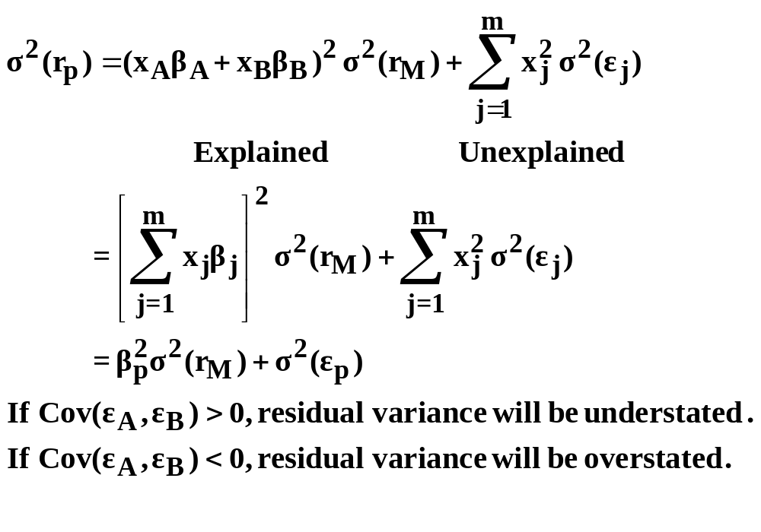
Explained Vs. Unexplained Variance (A Two Stock Portfolio Example) Continued

Slide 18

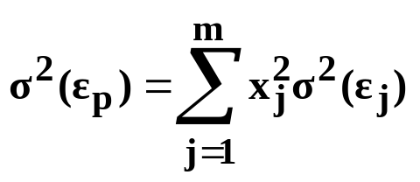
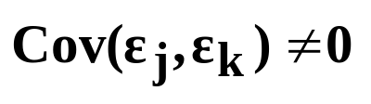
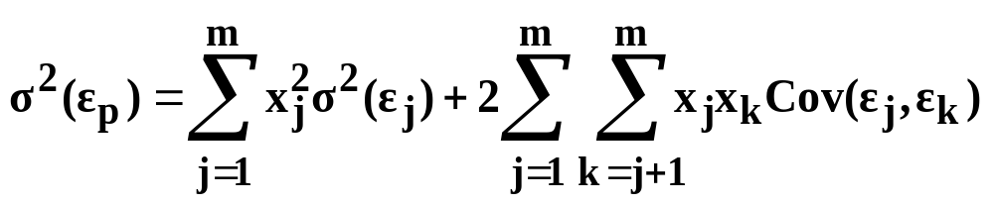
A Note on Residual Variance
The Single-Factor Model assumes zero correlation between residuals:
In this case, portfolio residual variance is expressed as:
In reality, firms’ residuals may be correlated with each other. That is, extra-market events may impact on many firms, and:
In this case, portfolio residual variance would be:

Slide 19
Markowitz Model Versus the Single-Factor Model
(A Summary of the Data Requirements)
Markowitz Model
  Number of security variances = m
  Number of covariances = (m² - m)/2
  Total = m + (m² - m)/2
  Example - 100 securities:
    100 + (10,000 - 100)/2 = 5,050
Single-Factor Model
  Number of betas = m
  Number of residual variances = m
  Plus one estimate of σ²(r_{M})
  Total = 2m + 1
  Example - 100 securities:
    2(100) + 1 = 201

Slide 20
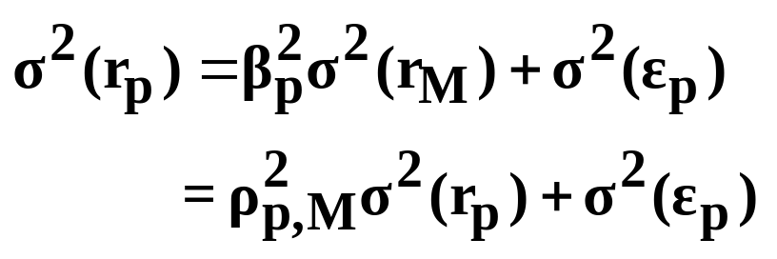
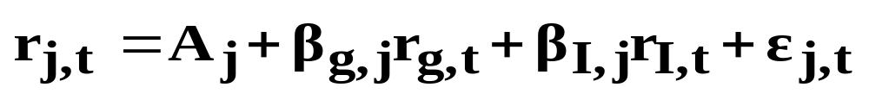
Multi-Factor Models
Recall the Single-Factor Model’s formula for portfolio variance:
If there is positive covariance between the residuals of stocks, residual variance would be high and the coefficient of determination would be low. In this case, a multi-factor model may be necessary in order to reduce residual variance.
A Two Factor Model Example
where: r_{g} = growth rate in industrial production
r_{I} = % change in an inflation index

Slide 21

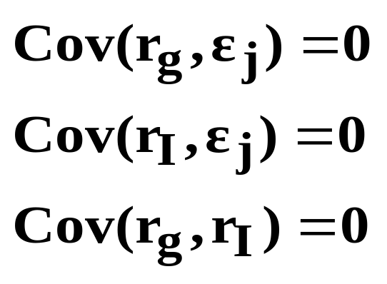
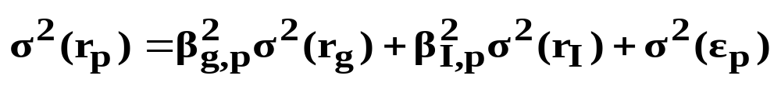
Two Factor Model Example - Continued
Once again, it is assumed that the covariance between the residuals of the the individual stocks are equal to zero:
Furthermore, the following covariances are also presumed:
Portfolio Variance in a Two Factor Model:

Slide 22
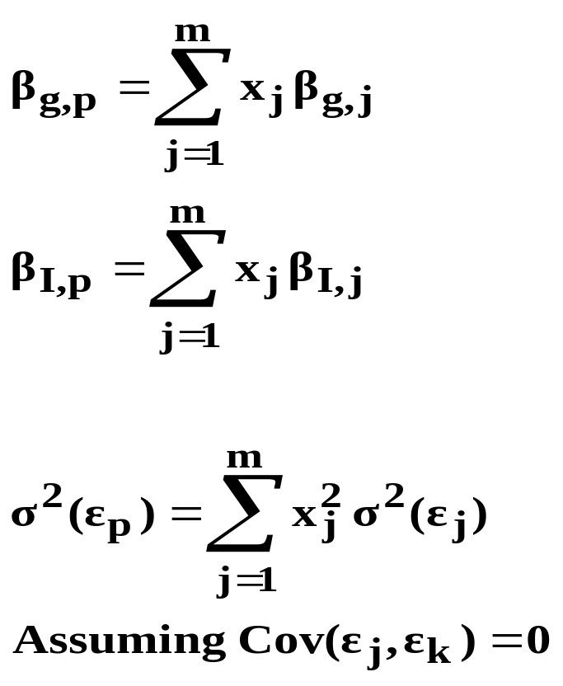
where:
Note that if the covariances between the residuals of the individual securities are still significantly different from zero, you may need to develop a different model (perhaps a three, four, or five factor model).

Slide 23
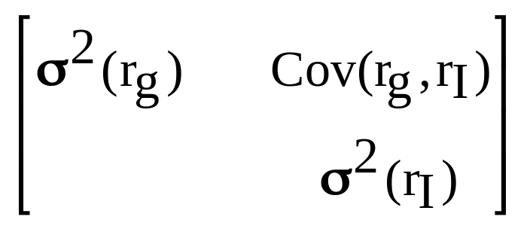
Note on the Assumption Cov(r_{g},r_{I} ) = 0
If the Cov(r_{g},r_{I}) is not equal to zero, the two factor model becomes a bit more complex. In general, for a two factor model, the systematic risk of a portfolio can be computed using the following covariance matrix:
To simplify matters, we will assume that the factors in a multi-factor model are uncorrelated with each other.
β_{g,p}
β_{I,p}
β_{g,p}
β_{I,p}

Slide 24
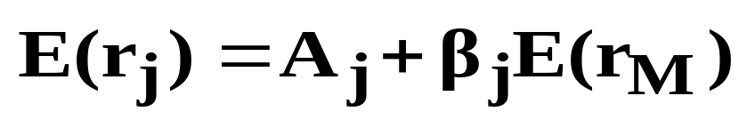
Models for Estimating Expected Return
One Simplistic Approach
  Use past returns to predict expected future returns. Perhaps useful as a starting point. Evidence indicates, however, that the future frequently differs from the past. Therefore, “subjective adjustments” to past patterns of returns are required.
Systematic Risk Models
  One Factor Systematic Risk Model:
  Given a firm’s estimated characteristic line and an estimate of the future return on the market, the security’s expected return can be calculated.

Slide 25
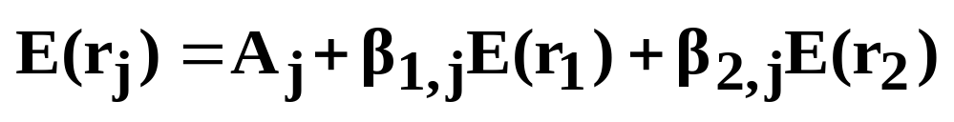
Models for Estimating Expected Return
(Continued)
  Two Factor Systematic Risk Model:
  N Factor Systematic Risk Model:
Other Factors That May Be Used in Predicting Expected Return
  Note that the author discusses numerous factors in the text that may affect expected return. A review of the literature, however, will reveal that this subject is indeed controversial. In essence, you can spend the rest of your lives trying to determine the “best factors” to use. The following summarizes “some” of the evidence.

Slide 26
Other Factors That May Be Used in Predicting
Expected Return
Liquidity (e.g., bid-asked spread)
  Negatively related to return [e.g., Low liquidity stocks (high bid-asked spreads) should provide higher returns to compensate investors for the additional risk involved.]
Value Stock Versus Growth Stock
  P/E Ratios
    Low P/E stocks (value stocks) tend to outperform high P/E stocks (growth stocks).
  Price/(Book Value)
    Low Price/(Book Value) stocks (value stocks) tend to outperform high Price/(Book Value) stocks (growth stocks).

Slide 27
Other Factors That May Be Used in Predicting Expected Return (continued)
Technical Analysis
  Analyze past patterns of market data (e.g., price changes) in order to predict future patterns of market data. “Volumes have been written on this subject.
Size Effect
  Returns on small stocks (small market value) tend to be superior to returns on large stocks. Note: Small NYSE stocks tend to outperform small NASDAQ stocks.
January Effect
  Abnormally high returns tend to be earned (especially on small stocks) during the month of January.

Slide 28
Other Factors That May Be Used in Predicting Expected Return (continued)
And the List Goes On
  If you are truly interested in factors that affect expected return, spend time in the library reading articles in Financial Analysts Journal, Journal of Portfolio Management, and numerous other academic journals. This could be an ongoing venture the rest of your life.

Slide 29
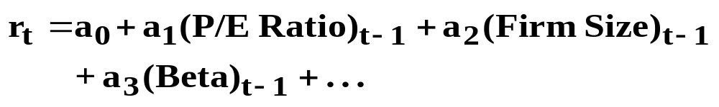
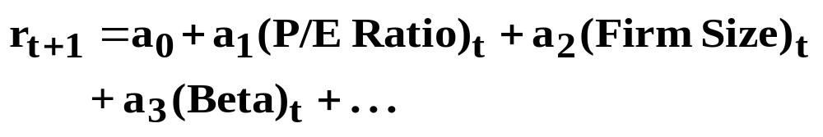
Building a Multi-Factor Expected Return Model:
One Possible Approach
Estimate the historical relationship between return and “chosen” variables. Then use this relationship to predict future returns.
  Historical Relationship:
  Future Estimate:

Slide 30
Using the Markowitz and Factor Models to Make Asset Allocation Decisions
Asset Allocation Decisions
  Portfolio optimization is widely employed to allocate money between the major classes of investments:
    Large capitalization domestic stocks
    Small capitalization domestic stocks
    Domestic bonds
    International stocks
    International bonds
    Real estate

Slide 31
Using the Markowitz and Factor Models to Make Asset Allocation Decisions Continued:
Strategic Versus Tactical Asset Allocation
Strategic Asset Allocation
  Decisions relate to relative amounts invested in different asset classes over the long-term. Rebalancing occurs periodically to reflect changes in assumptions regarding long-term risk and return, changes in the risk tolerance of the investors, and changes in the weights of the asset classes due to past realized returns.
Tactical Asset Allocation
  Short-term asset allocation decisions based on changes in economic and financial conditions, and assessments as to whether markets are currently underpriced or overpriced.

Slide 32
Using the Markowitz and Factor Models to Make Asset Allocation Decisions Continued
Markowitz Full Covariance Model
  Use to allocate investments in the portfolio among the various classes of investments (e.g., stocks, bonds, cash). Note that the number of classes is usually rather small.
Factor Models
  Use to determine which individual securities to include in the various asset classes. The number of securities available may be quite large. Expected return factor models could also be employed to provide inputs regarding expected return into the Markowitz model.
Further Information
  Interested readers may refer to Chapter 7, Asset Allocation, for a more indepth discussion of this subject. In addition, the author has provided “hands on” examples of manipulating data using the PManager software in the process of making asset allocation decisions.

